Slide 1
Vivaha muhoorata

Slide 2
It is always good to marry in shubh and unafflicted lagna
Type of Marriage as per Vedic culture
Bramha vivaha: when the marriage happens with the most eligible candidate with kanyadaan. Girl is felicitated with the presence of limited family members
Daiv vivaha: when marriage happens with an intelligent and knowledgeable person who has came for some auspicious ceremony. In today’s situation when marriage happens with a knowledgeable person without any public ceremony can be considered like this.
Arsha vivaha: when marriage happens with an exchange for something from the groom side. Like boy’s side will give certain things to the bride side. Money is not considered in this

Slide 3
Prajpatya vivaha: this is now a days happens in most of the cases where boys and girls' family meet and they finalize marriage with some dowry in front of some pundit
Aasur vivaha: Money is taken from groom side in exchange of the girl
Gandarva vivaha: today’s love marriage
Rakshasa vivaha: when girl marry to a man who has won her in any war, speculation etc
Pischacha vivaha: when through deceiving, through power,through fear etc
There is no consent of girl in Asur,Rakshasa and Pischacha vivaha.

Slide 4
In prajpatya,arsha, brahma and daiva vivaha it is important to consider shubh day, tithi, seasons etc but in rest of the vivaha its not necessary to work out muhoorat, lagna shudhi is important in all the vivaha
Through marriage a person get rid of pitrarinn,devrinn and rishirinn and its an entry point of grahstha ashram.
Rishi’s has directed that along with a priest one astrologer should be there at the time of marriage since through marriage many of arishta yoga of your chart also gets rectified. If the priest himself is an astrologer its always great.

Slide 5
Muhoorat through prashna lagna
If moon is in 3,7,5,10,11 houses from the prashna lagna and aspected by guru the marriage will happen soon.
If the lagna is in 2,7,4 aspected by shubh graha the marriage will happen soon
If moon or venus is in 2,7,4 lagna or lagna is aspected by moon or venus, the marriage will happen soon.
If moon and venus is in odd sign or navmasha and strong and aspecting the lagna then also marriage will happen soon for girl
If both are into even sign and even navmasha then also marriage happen soon for boy

Slide 6
Bad Indications
If moon is in 6,8 house from the prashna lagna, husband can die or marriage is in problem. Specially after 8 yrs
If any malefic in the prashna lagna and mangal is in 7th or Moon is in the lagna and mangal is in 7th then also marriage will not last more than 8 yrs. Mars is an indication, any malefic will create problem in the marriage related to its signification.
If any malefic in the 5th house and in debility and aspected by any enemy planet, the girl can be of loose character or produce dead kids.

Slide 7
Vivaha bhang yoga
If moon is in Krishna paksha and in 2,4,6,8,10,12 signs or 6,8 th house aspected by malefic planets the marriage can break after fixation or can result in divorce.
Remedies for bad marriage indication, divorce, widowhood etc
The girl should marry to people tree, before this she should do vat savatri vrat on amavashya. The girl should pour water in the roots of peepel tree for one month and after this ritual she should worship Maa Parvati at home.
Best to start this vrat at Chaitra or Ashwin months Tritiya to next Krishna Tritiya.
This should be kept complete secret other than mother,father and jyotishi
This should be done in case of complete widow yoga for other problems in the marriage marriage with Vishnu idol, kumbha vivaha is suggested. Vishnu idol can be of gold or silver

Slide 8
Peeple tree marriage
Take a peepel tree in a Pot
The marriage should be below the banyan tree but before this the person should be fasting for one month
Don’t put the pot in your home. When the fasting for one month is complete, one should bring the peeple tree to their home and the girl should marry to the tree. It should be done in secrecy.
After the marriage the girl and peepel tree should go out from home as a vidai ceremony and tree should be dropped at any temple. The brother of the girl should take the girl back to home.
In the kumbha vivaha the kalash should be placed and the girl should marry it.

Slide 9
Deciding the marriage time
For girl the gurubal is to be seen at the time of marriage and for boy surya bal is to be seen.
Chandra bal is to be checked for both(12th Chandra is neutral )
Planet | Surya | Chandra | Guru
Shubh | 3,6,10,11 | 3,6,7,10,11 | 2,5,7,9,11
Pujya | 1,2,5,7,9 | 1,2,5,9 | 10,6,1,3
Denied | 4,8,12 | 4,8,12 | 4,8,12

Slide 10
Month of birth and Marriage
The first child marriage should not be done on Chandra tithi,janma nakshtra
Second child (if he is the eldest since he is only alive) he can get married on these dates
The eldest if he married on these days creates problem in progeny and kulvridhi
If its necessary to marry in the same month atleast avoid the paksha(Krishna or Shukla) and nakshtra
Janma rashi and lagna and 8th from janam lagna- lagna(i.e. 8th lord lagna) should be avoided
Eldest son, eldest daughter and jyestha mass are called trijayestha. So marriage of eldest in jyaestha mass is always restricted.
If one of boy and girl is eldest then its medium shubh to marry in jayestha mass
If no one is eldest then its ok to marry in jayestha month if all three parameter of guru,Chandra and surya is matching
According to garga rishi marriage of two eldest is anyways not welcome
Its not advisable to marry the daughter within 6 months of son’s marriage. Applicable to only one parent family
In the joint family it is advisable not to do “mundan” after 6 months of marriage but after mundane marriage can happen within 6 months.
2 real sisters should not marry to 2 real brothers
Mundan of 2 brothers should not be done together
2 real sisters should not marry to a single man

Slide 11
During the time of marriage shrad,tarpan, pitra kriya should not be done
Twins can marry within 6 months even in one day at same place
Step brothers sisters can also marry with in 6 months
In case of twin the elder should marry first then the younger even in the same mandap same day
Exchange of girl and boy like my son will marry to your daughter and my daughter will be married your son is restricted
Engagement,roka,marriage should not be done in case of death of father, grand father, great grand father, if necessary to do then after doing all the rituals it can be done
Generally in case of father’s death 1 year, 6 months for mother, for brother, nephew 45 days is restricted
Father, chacha, chachi, tau, son,brother, married sister when they die sutak is there, all the manglik work is delayed for decided time.
For shanti vinyak(ganesh) shanti and cow donation is done
Sutak is not considered for people who are sanyasi, living in foreign or remote place or left the home permanently.

Slide 12
People born in ashlesha(last 3 charan) can create problem for some people. Boy and girl can be bad for their mother in law
Mool(first 3rd charan) born can be dangerous for father in law
Jayestha born girl can be bad for elder brother of husband, vishaka(4th charan) born girl can be dangerous for dewar

Slide 13
Gun Milan
Name | Marks | Significance
Varna | 1 | Working capacity
Vashya | 2 | Prominence
Tara | 3 | fortune
Yoni | 4 | Mentality
Graha maitri | 5 | Cooperation
Gnan maitri | 6 | Gun prominence
Bhrakoot | 7 | Love
Naadi | 8 | health
 | 36

Slide 14
Varna
Rashi | Varna
4,8,12 | Brahmin
1,5,9 | Kshatriya
2,6,10 3,7,11 | Vaishya shudra

Slide 15
If girl comes from higher varna and boy comes from lower varna the 0 marks
If its equal or girl varna is less then or equal 1 mark
Boy varna | Girl varna | Guna | Boy varna | Girl varna | guna
Brahmin | Any varna | 1 | Kshatriya | Brahmin | 0
Vaishya | Brahmin, kshtriya | 0 | Kshatriya | Rest 3 | 1
Vaishaya | Vaishya,shudra | 1 | Shudra | Rest 3 | 0
 |  |  | Shudra | Shudra | 1

Slide 16
vashya
Dwipada | 3,6,7,11
Chatuspada | 1,2,5,9,10(first half)
Jalchar | 4,12,10(second half)
vanchar | 5
keet | 8

Slide 17
Vashya
Groom rashi | Dwipada | Chatspada | Jalchar | Vanchar | keet
Dwipada | 2 | 1 | 1 | 0 | 1
chatuspada | 1 | 2 | 2 | ½ | 2
jalchar | 1 | 1 | 2 | 1 | 1
Bride rashi
vanchar | 0 | 0 | 1 | 2 | 0
keet | 1 | 2 | 1 | 0 | 2

Slide 18
Tara vichar
From girl nakshtra count the boy nakshtra, count from boy nakstra to the girl nakstra and divide that number by 9
If the remaining is 3,5,7 then its bad
Rest are shubh
Total count for this is 3
If both the times the reminder is 2,4,6,8,0 then 3 marks
If at one place 3,5,7 the marks are 1.5 and in both reminder is 3,5,7 the mrks are 0
For example if the boy nakstra is Ashwini to girl nakstra jyestha the total is 18. divided 18/9=0 . To jyestha to Ashwini 11/9=2 so its good and 3 marks will be counted.

Slide 19
Yoni vichar
Ashwini, satvisha | ashwayoni | enemies
swati-hasta | mahisha
dhanistha-purvabhadrapad | singh yoni | enemies
bharini-revati | hathi
pushya-kritaka | mesha
shravan-purvashada | vaanar
uttarshada-abhijeet | nakul
mragshira-rohini | sarpa
jyestha-anuradha | hiran
mool-adra | swan
punarvasu-ashlesha | maarzar
magha-purvafalguni | mooshak
vishaka-chitra | vyagraha
uttarfalguni-uttarabhadrapad | gou

Slide 20
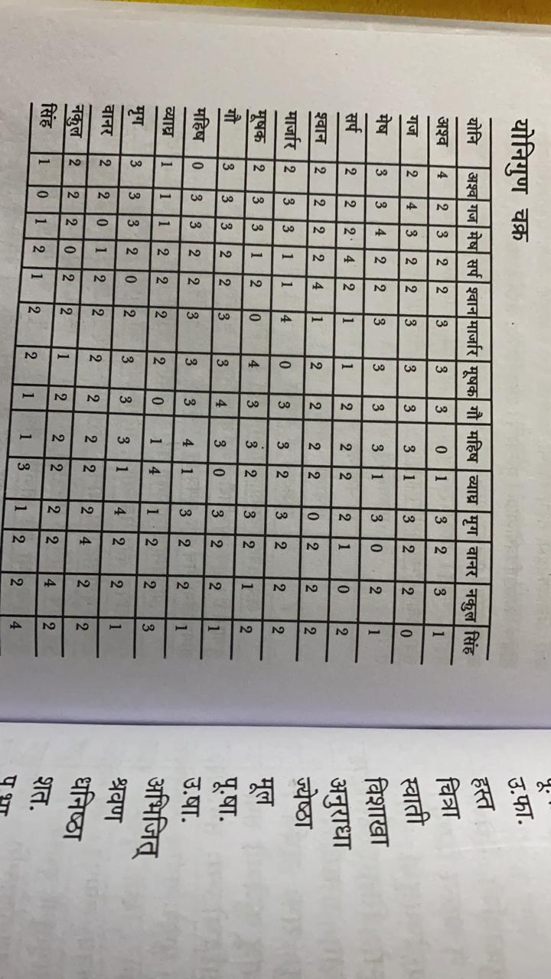

Slide 21
Graha maitri
Planet | Friends | Enemy | Neutral
Surya | mangal,guru,chandra | shukra,shani | mercury
Chandra | surya,budh | all neutral
mangal | surya,chandra,guru | chandra | guru,shani,mangal
budh | shukra,surya | chandra | guru,shani,mangal
guru | surya,mangal,chandra | budha,shukra | shani
shukra | budh,shani | surya,chandra | mangal,guru
shani | budh,shukra | surya,mangal,chandra | guru

Slide 22
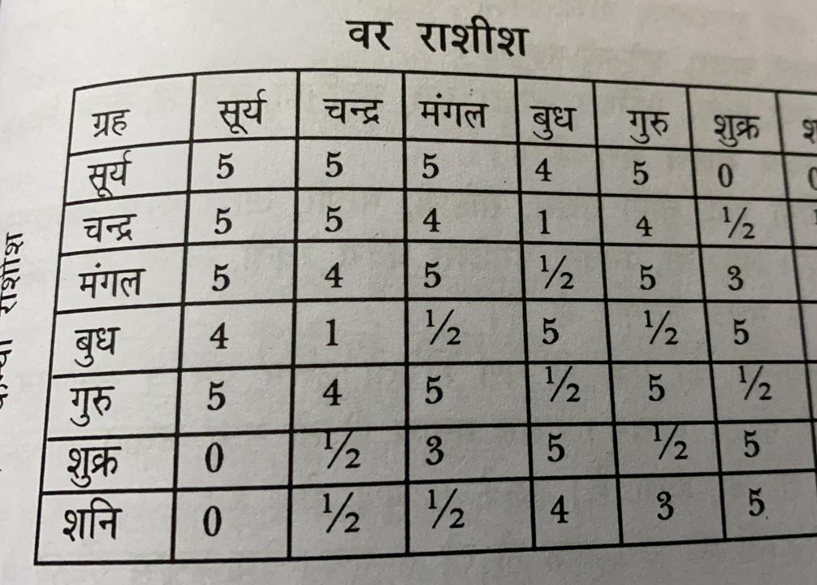
Mitra or one-5
Sum-mitra-4
Sum-sum-3
friend-enemy-1
Sum-enemy-1/2
Enemy-enemy-0

Slide 23
Gan vichar

Slide 24
If there is rashi maitri or d9 rashi matri the dosha is solved if the first 6 criteria is also matching then also marriage will be fine
boy | deva | Manshua | rakshasha
dev | 6 | 5 | 1
manushya | 6 | 6 | 0
rakshaha | 0 | 0 | 6

Slide 25
vrakoot
If the signs of male and female are 6/8 from each other than death will occur
If they are 9/5 then loss of the child
2-12 gives poverty
3-11,7,4,10 or own sign the happiness
The total of vrakoot is 7.
If the rashi are 7th from each other then its shubh and if the girl rashi is 12th from boy then also it is considered good.
4/10 rashi 5/11 rashi even they are 7th but considered bad because of enemity between surya-shani, Chandra-shani

Slide 26
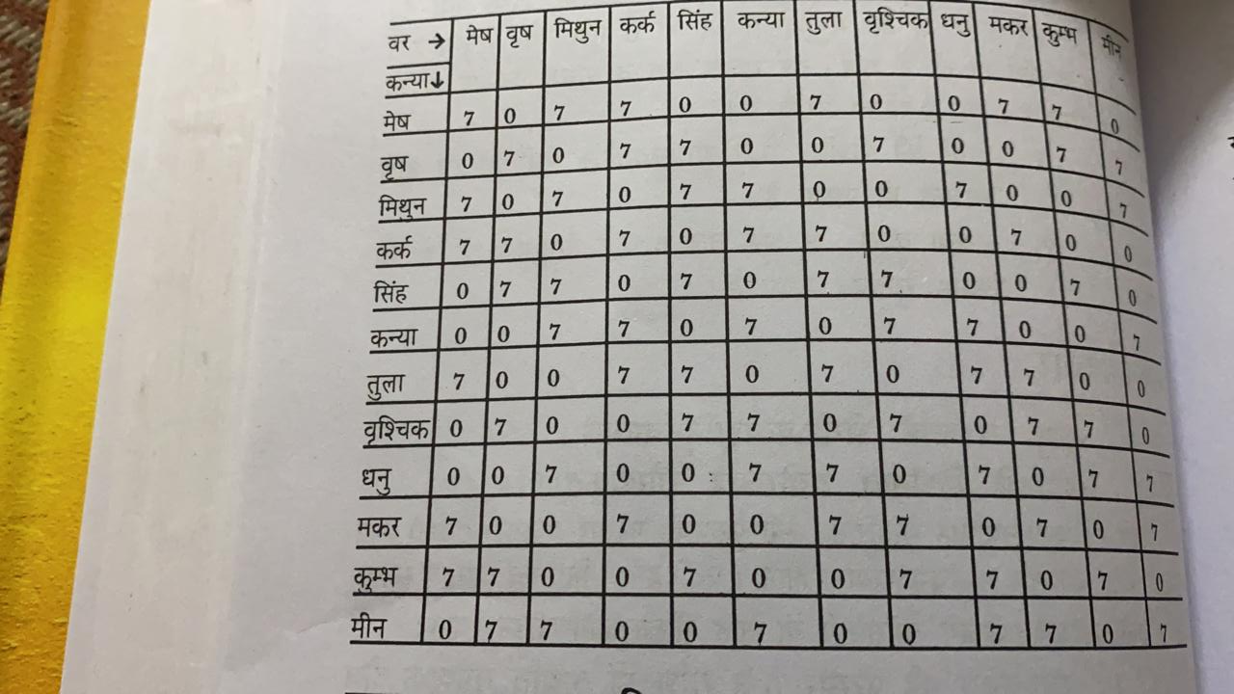

Slide 27
Exception for vrakoot dosha
If the rashi lord are same then the dosha is cancelled
If the rashi lord are friendly to each other . For example leo and meena are 6/8 but lords are friend so the dosha is cancelled
1-8,2-7,4-9,5-12,3-10,6-11 are called mitra shadasthak
1-6,11-12,2-9,4-11,5-11,3-8 are called shatru shadasthak and considered very bad
If there is no nadi dosha but tara shudhi and vasya are ok then also vrakoot can be left and marriage can be frutiful

Slide 28
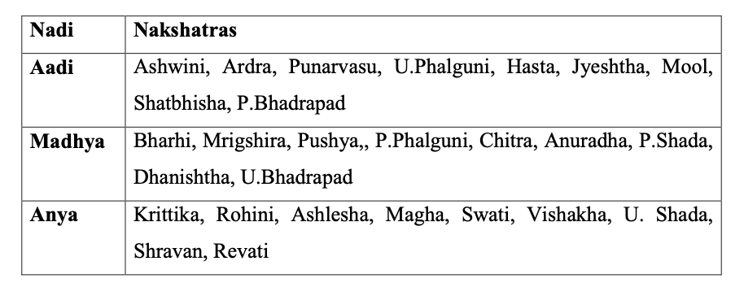
NAADI DOSHA

Slide 29
If the nadi are same for girl and boy , the marriage will always be bad for both. Specially if its Madhya nadi death can occur
anya nadi will cause widowhood, adhya will cause separation
Nadi has 8 points and the most important aspect of ashtakoot gun milan
This nadi dosha is to be seen in marriag, guru- shishya or devata- bhakta also
For every nakstra the first charan will have vedha with fourth
Second- third will have vedha
Third- second
4th with 1
If there is a vedha then even the nadi dosha is there but marriage can take place. This is an exception
Nadi dosha can be cured only through charan vedha if the dosha is there but someone wants to marry the maha mritunaya japa, donation of gold, cow, cloths etc are to be done.

